Slide 1
Development Introduction
Classroom Presenter 3.0

Slide 2
“Model”
Keeps all of the application’s global state.
Forms a hierarchy of classes and components.
Allows UI and back-end to listen for changes via PropertyPublisher interface.
Enforces thread safety.

Slide 3
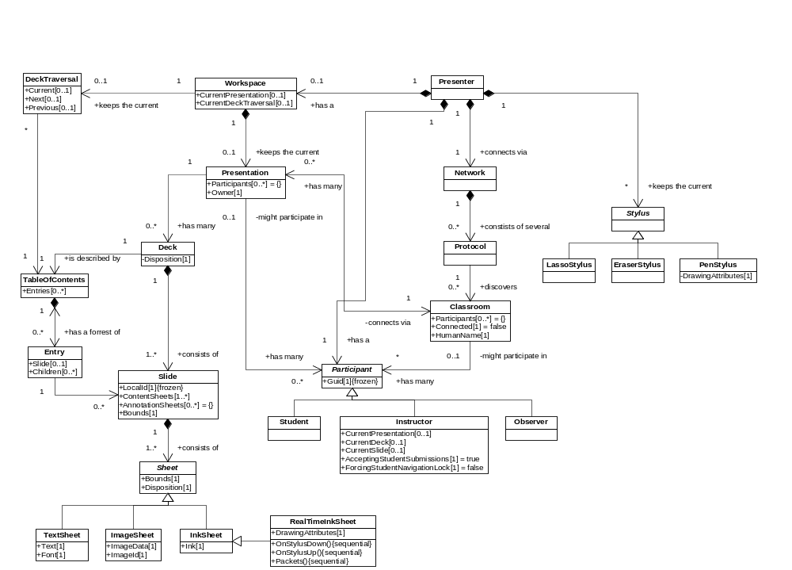
Model UML

Slide 4
Thread Safety
Model objects each have their own ReaderWriterLock.
Exceptions thrown if caller does not obtain a lock — forces developer to think about threading issues.
model.RWL.AquireReaderLock(Timeout.Infinite);
try {
// Perform operations requiring read access to model.
} finally {
model.RWL.ReleaseReaderLock();
}

Slide 5
Locking Model
“Fine-grained”.
A design decision:
  We can always make locking “coarser” if necessary.
    This has already been done with the TableOfContents model.
  The reverse is not possible.
ReaderWriterLocks may not benefit performance, but allow safety enforcement.

Slide 6
Back-End Development
Back-end components will access model
  No direct access to UI components.
UI displays state by hooking into model’s event listeners.
someModel.Changed[“PublishedProperty"].Add(new PropertyEventHandler(this.HandlePublishedPropertyChanged);
Only issue is removing event listeners when components are Disposed to prevent memory leaks.

Slide 7
DeckBuilder Back-End
Serialization and deserialization of
CSD ↔ DeckModel
Invoked directly by UI during file Open or Save command.
Invoked by Networking back-end for broadcast?

Slide 8
Networking Back-End
Different Back-Ends for each supported protocol (RTP, ConferenceXP Capability).
Each back-end accessed via its ProtocolModel object.
Back-end is responsible for populating list of “classrooms” (venues).
Listens to events coming from the ClassroomModel objects.
  When the classroom’s Connected property is set to true by the UI, the back-end connects and populates the list of available presentations.
Generates and listens to events from all aspects the model regarding decks, slides, sheets, ink, navigation, etc. and automatically broadcasts changes to students.

Slide 9
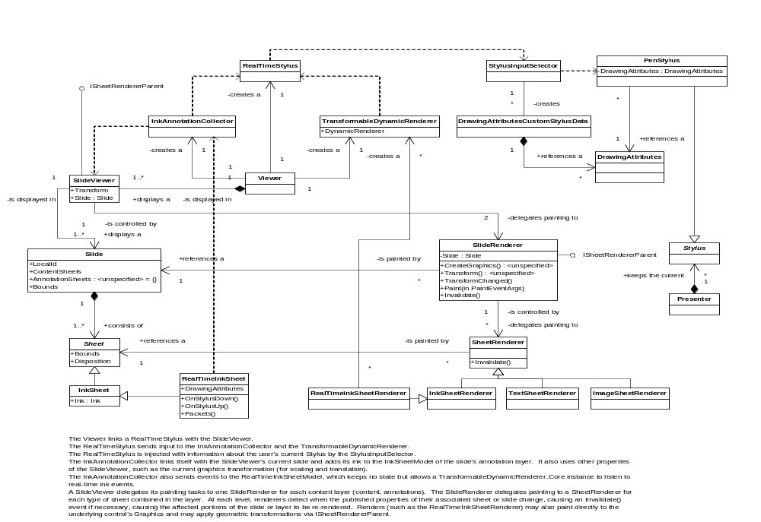
UI UML

